Slide 1
CREATiVE
THINKING
WORKSHOP

Slide 2
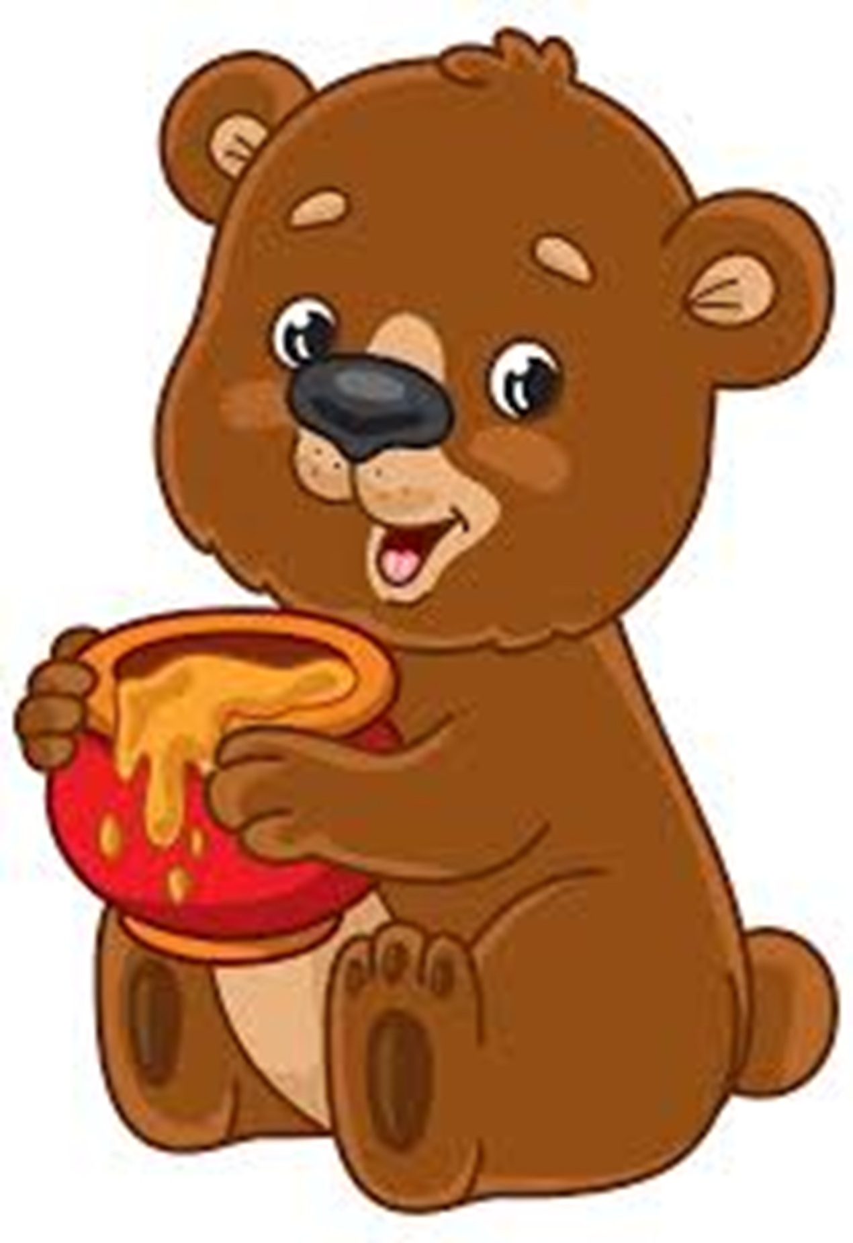
94% of hiring managers consider creativity important when selecting
a candidate.
Gallop 2023

Slide 3
40% of people fear making a mistake (US).
It increases to 52% in the United Kingdom.
Workplace Insight 2023

Slide 4
Up to 50% of
the increase in productivity
is attributed to cohesive teams exercising creativity.
Gallop 2023

Slide 5
Creativity leads to innovation.
Innovation leads to revenue.
Creativity = Value
Forbes 2023

Slide 6
@DrTroyHall
GROUP ACTIVITY
Three of a Kind

Slide 7
DE
BRIEF
ING

Slide 9
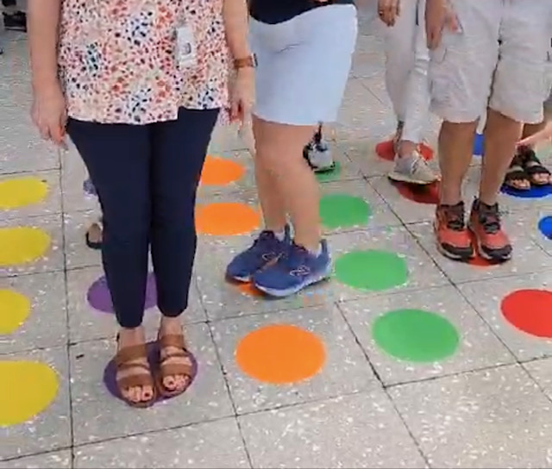
@DrTroyHall
BREAKout ACTIVITY
MIND READER
Online Version

Slide 10
Try. Refine. Implement. Evaluate. Succeed.
deBRIEF
experimentation

Slide 11
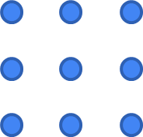
Nine Dot Activity
2
1
4
3

Slide 13
STORYtime
Bears, honey, and telephone poles
Solutions from the ridiculousness of trying

Slide 14
Your AHAs
and
Session Survey

Slide 15
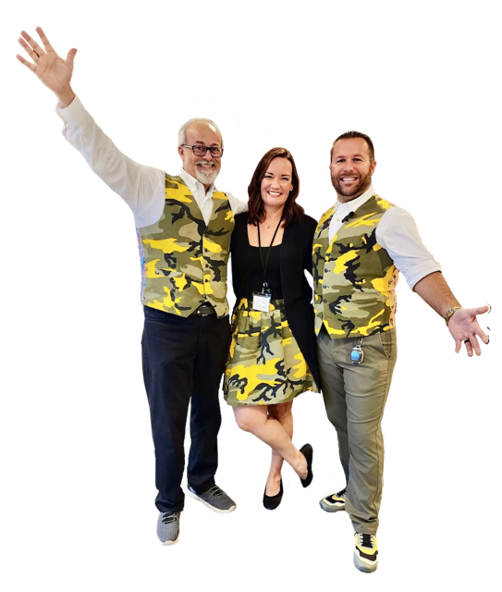
@DrTroyHall
Cohesion
Culture™ Crew
Dr. Troy. Karmen Zabron. Ben-Jamin Toy
info@CohesionCulture.net
CohesionBooks.com
#1
ORDER ON AMAZON

