Slide 1
POWERup
Your Leadership

Slide 2
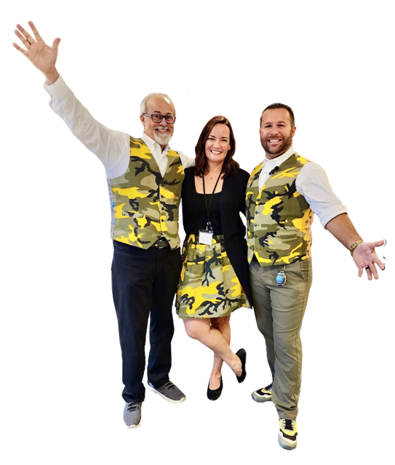
@DrTroyHall
Cohesion
Culture™ Crew
Dr. Troy. Karmen Zabron. Ben-Jamin Toy
info@CohesionCulture.net
CohesionBooks.com
#1
ORDER ON AMAZON

